Slide 1


SLEEP HEALTH ANALYSIS
BY: DATA BUS
Notes:
Hello everyone, before we start, I wanted to ask you all: Have you ever had a bad night of sleep? How about consecutive bad nights of sleep: maybe even sleep apnea or insomnia? Do we ever wonder if there are factors that affect our sleep? My name is Jesus, our team name is Data Bus and today we will be talking about Sleep Health.

Slide 2
MEET THE TEAM
TODAY’S AGENDA
Anto Kim
Final Polishing
Slides Editing
Presentation Script
Priyangka Roy
EDA
Dashboard 1
Presentation Slides
Jesus Acevedo
Data Preprocessing
Dashboard 2
Presentation
Introduction
Process Data
Understand
Pre-process
Analyze
Insights
Summary
Notes:
Our team consists of 2 current BIA students: myself (Jesus) and Anto and 1 alumni: Priyangka. You can see here what our roles were in this project. Our agenda for the day will be:
Introduction
Process
Insights
Summary

Slide 3
Sleep disorders including insomnia and sleep apnea, are significant public health issues linked to various physical and mental health problems exacerbated by stress, sedentary behavior, and poor sleep hygiene.
According to the American Sleep Association:
50-70 million U.S. adults suffer from a sleep disorder.
Insomnia affects about 30% of adults with short-term issues and 10% with chronic insomnia
Sleep apnea impacts an estimated 25 million adults.
Today, we will focus on:
Factors affecting sleep disorders
Potential improvements to overcome sleep disorders
Impact sleep disorders have on different occupations.
INTRODUCTION
Notes:
*Read the slide*

Slide 4

1 Understanding Data
PROCESS
2 Pre-processing Data
3 Analyzing Data/Insights
Notes:
The processing portion of our project consisted of 3 stages: understanding the data we were working with, pre-process it: making sure we removed duplicates or took care of missing values and lastly but not least, analyze the data and derive insights.

Slide 5
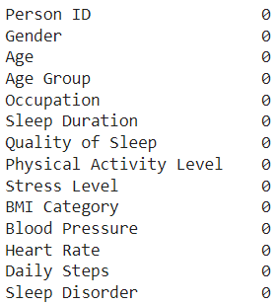
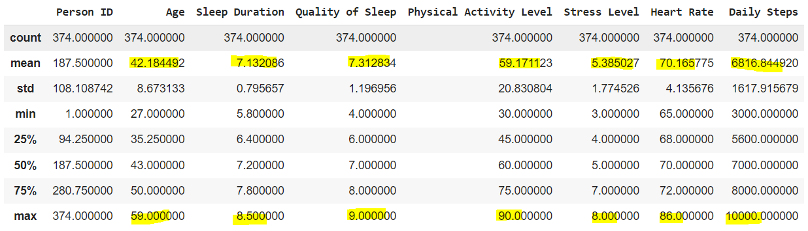
Missing Values
Duplicates
1. Understanding Data
Summary Statistics
Notes:
The mean age of the population sample in the dataset is 42, the mean sleep duration is 7 hours with a maximum of 8, quality of sleep mean is 7 with a maximum of 9, activity level mean is 59 with the max range at 90, stress level mean is 5.38 with a maximum of 8

Slide 6
4 Age Groups were created:
27-29 year olds
30-39 year olds
40-49 year olds
50-58 year olds
BMI Category values were modified from:
‘Normal Weight’ -> ‘Normal’
2. Pre-processing Data
Notes:
In the pre-processing stage, we regrouped the age data into 4 categories: the twenties (which really only cover 3 years as compared to 10 for the other age groups), thirties, forties, and fifties (which again, doesn’t fully cover 10 years but almost).
We also modified the BMI category values as there were 2 data types that were one in the same- normal weight was changed to normal.

Slide 7
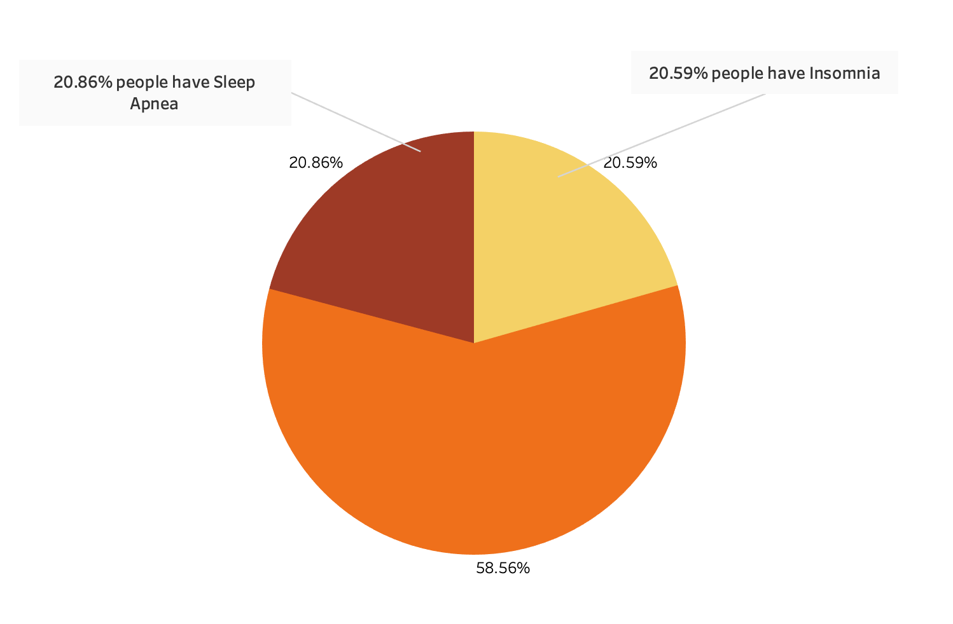
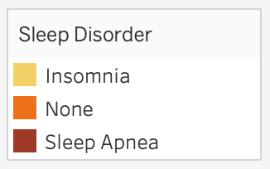
Proportion of Sleep Disorder
3. Analyzing Data/Insights
Notes:
Once we’ve pre-processed our data, we started looking at the proportion of sleep disorder amongst our whole data set. We can see in our pie graph that a little over half of our dataset reported not having any sleep disorders while the other half was about evenly divided into people having sleep apnea and insomnia. That means that a quarter of our data set reported having sleep apnea and a quarter insomnia. We wanted to then look at sleep disorder in the gender and age category.

Slide 8
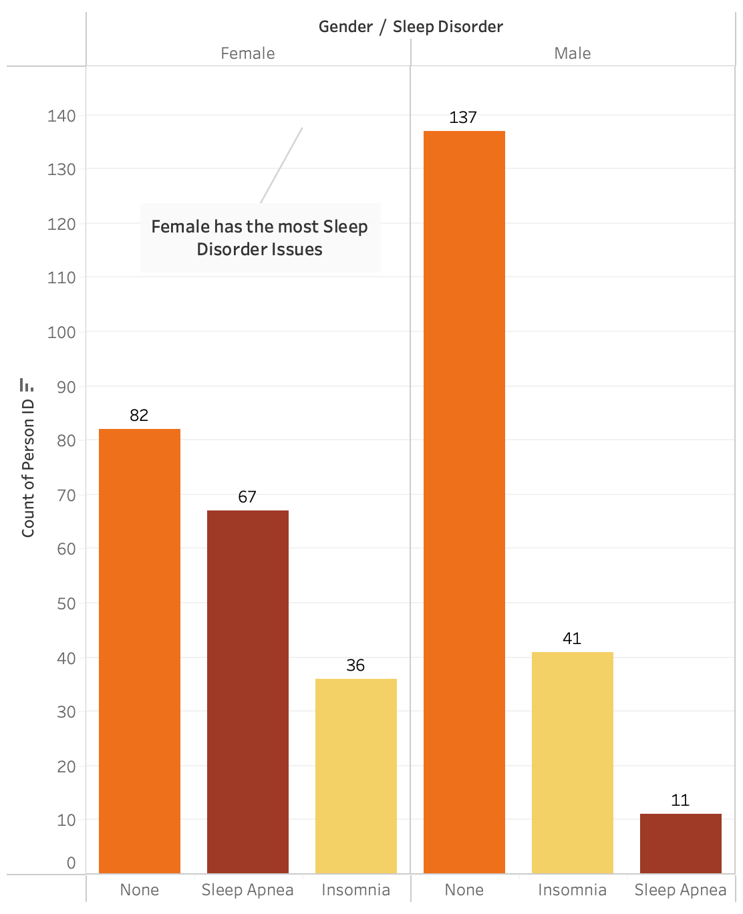
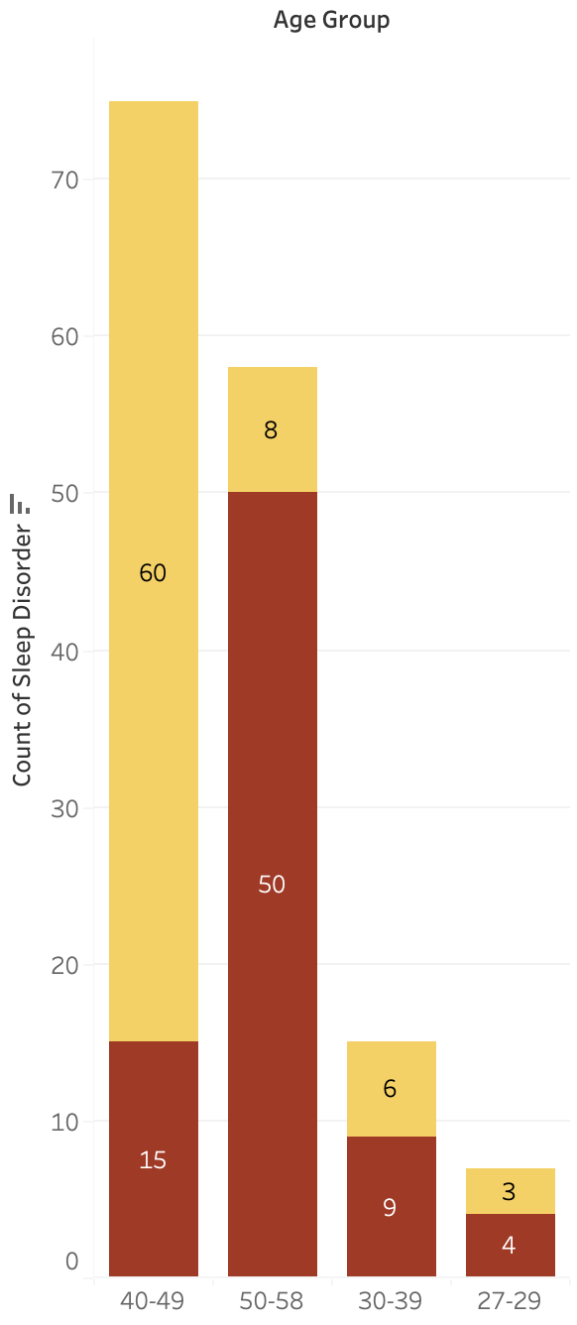
Sleep Disorder In Gender and Age Groups
3. Analyzing Data/Insights
Notes:
In the gender category, we can conclude a handful of insights:
There were significantly more males who reported not having any sleep disorders than females. Very few males reported suffering from sleep apnea while more males reported suffering from insomnia.
Females made up 85% of those who reported suffering from sleep apnea and about 46% of those who reported suffering from insomnia.
Overall, we can conclude that more females suffer from sleep disorders (insomnia or sleep apnea) than males.
In the age group category, we excluded those who reported that they did not suffer from any sleep disorder. We can conclude that:
Those in the forties age group suffer from sleep disorder the most- majority suffering from insomnia.
Coming in second, is the fifties age group. Now unlike the forties age group, the fifty year olds tend to suffer more from sleep apnea.
We can also conclude that as age groups get younger, the less they suffer from sleep disorders

Slide 9
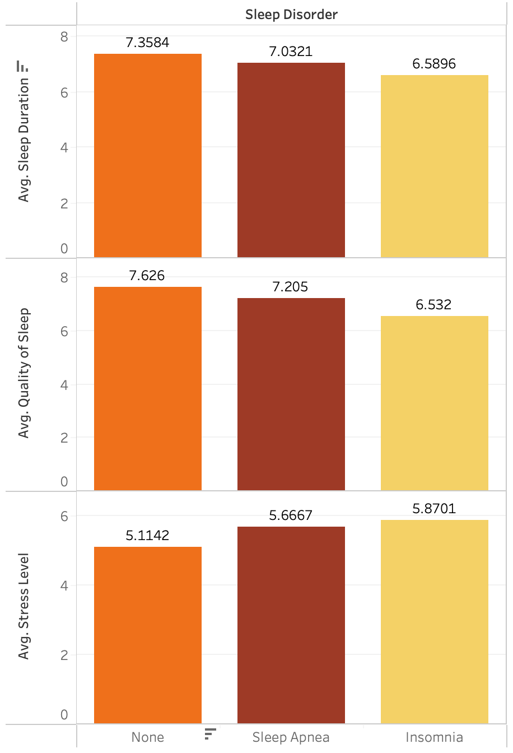
Sleep Disorder vs.
Avg. Quality Of Sleep, Stress Level and Sleep Duration
3. Analyzing Data/Insights
Notes:
We also analyzed how sleep disorder is related to the average quality of sleep, average stress level and average sleep duration. And as you may have already concluded, increased sleep duration and qualify of sleep is positively correlated to individuals reporting no sleep disorders. And the lower the stress level, the lower the reports for sleep disorders. Conclusion: make sure you get over 7 hours and 20 mins of sleep a night to decrease your chances of suffering from sleep disorders!

Slide 10
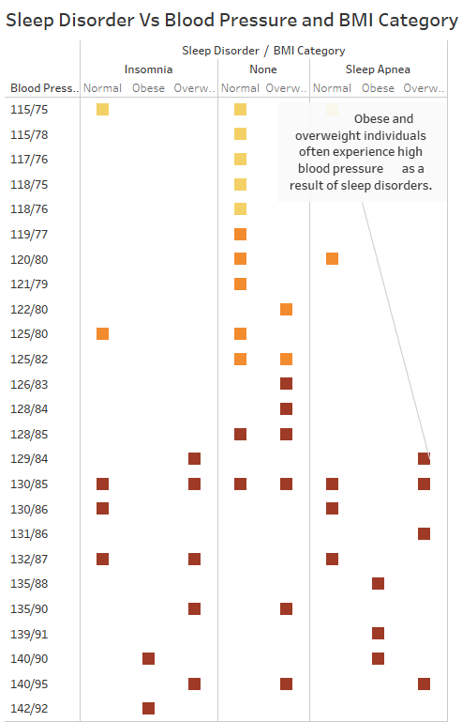

Sleep Disorder
vs.
Blood Pressure and BMI Category
3. Analyzing Data/Insights
Notes:
Another category we analyzed was blood pressure and BMI.
As you can see here, when we look at the “none” category of sleep disorder, there’s more individuals with either low, high and normal Blood Pressure. But in the insomnia and sleep apnea category, you can see that there really aren’t many individuals in the lower to normal BP levels. Meaning, that obese and overweight individuals often experience high blood pressure as a result of suffering from sleep disorders.

Slide 11
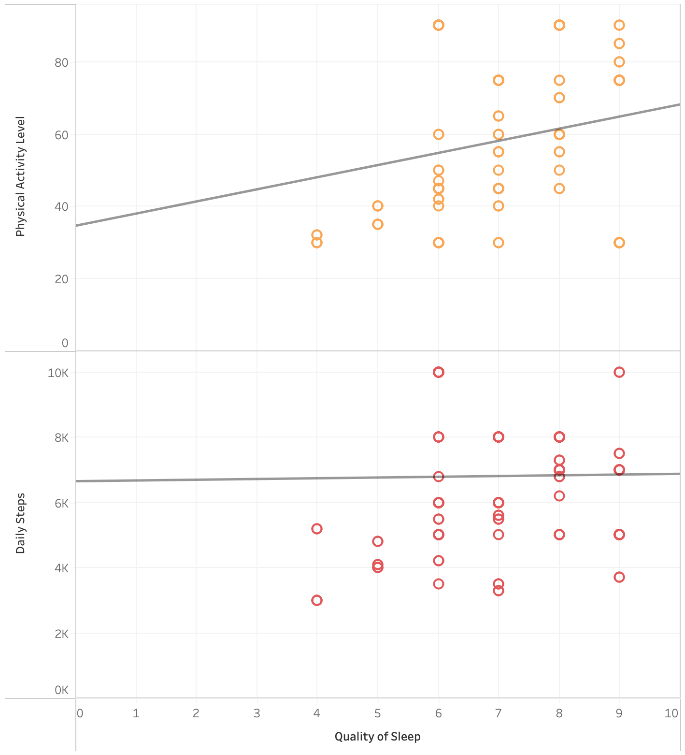
Relation between Quality of Sleep Vs Physical Activity Level and Daily Steps
3. Analyzing Data/Insights
Notes:
There is a Positive correlation between the two variables compared in this graph

Slide 12
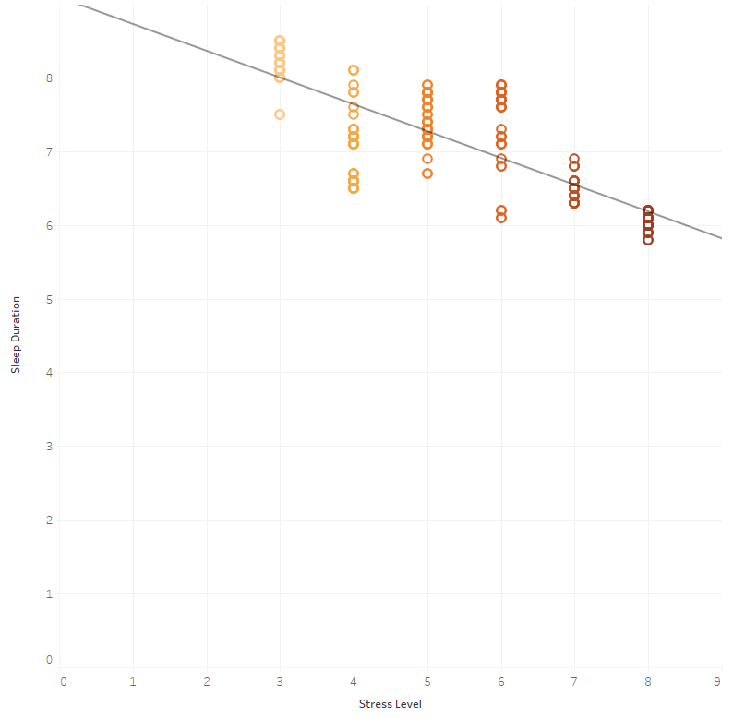
Relation between Stress Level and Sleep Duration
3. Analyzing Data/Insights
Notes:
In this graph the Lighter dots represent less stress levels with more sleep duration

Slide 13
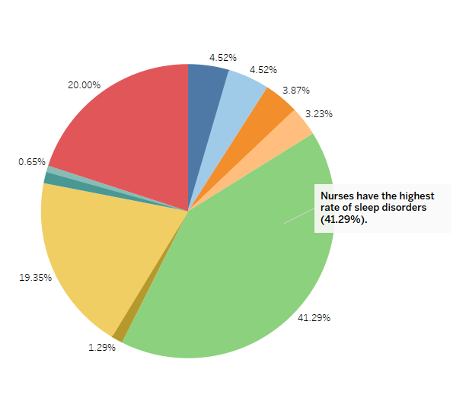
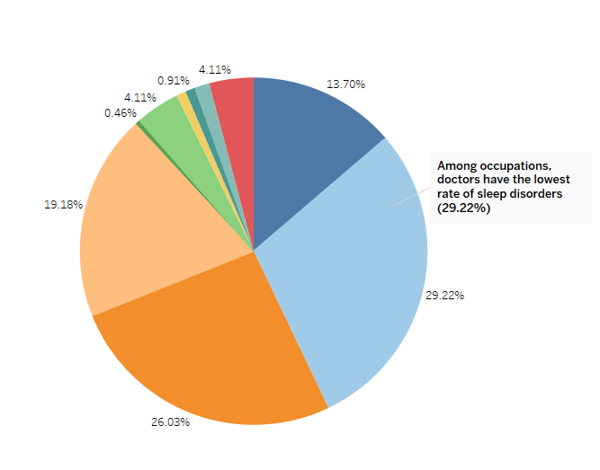
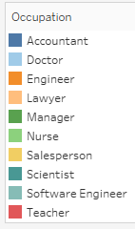
Sleep Disorder By Occupation
Occupations without sleep disorders
3. Analyzing Data/Insights
Notes:
We also compared sleep disorders by occupation, showing showing Nurse as the occupation with the highest rate of sleep disorders, taking up 41% of the pie chart on the left.
While the pie chart on the right shows the Doctor occupation as the one with the lowest rate of sleep disorders.

Slide 14
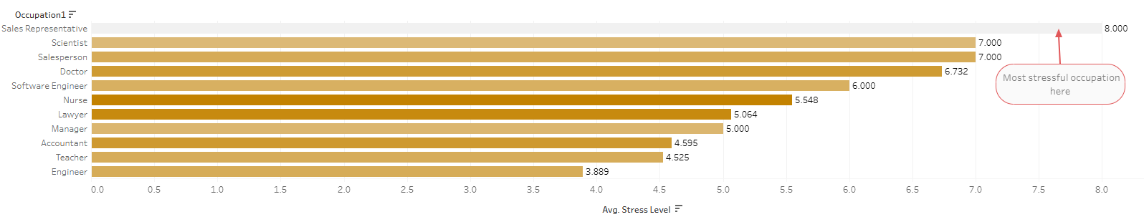
Stress Level by Occupation
3. Analyzing Data/Insights
Notes:
In this bar chart we can see that the Sales rep is the occupation with the highest stress level and the Engineer with the lowest stress level

Slide 15
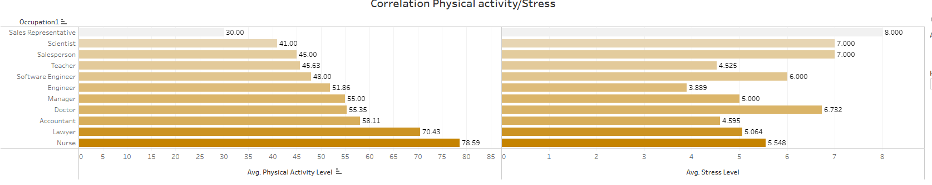
Correlation Physical activity/Stress
3. Analyzing Data/Insights
Notes:
Again, the Sales rep occupation has the lowest physical activity and the highest stress level on average

Slide 16
What factors most affect sleep disorders?
Quality Sleep, Stress Level, Sleep Duration, Blood Pressure, Body Weight
2. What are the potential improvements we can do to overcome this?
Increase physical activity, Increase duration of sleep and quality of sleep, Decrease stress levels
3. How do these issues impact different occupations?
Most stressful occupation is 'Sales Representative’
INSIGHTS
Notes:
We have learned that quality of sleep, stress level, sleep duration, blood pressure and body weight are the main factors that affect sleep disorders.
To overcome this, we can increase physical activity, increase duration and quality of sleep, while decreasing stress level.
These issues Impact occupation and viceversa, we clearly learned that the most stressful occupation is Sales Rep, While Engineers have the least stressful, occup.

Slide 17
Our analysis delved into:
Understanding sleep disorder, focusing on the factors that create sleep disorders and what steps we can take to overcome this issue.
Through visualizations, we provided valuable insights into the factors that most affect sleep disorders.
In fact, we found that the below factors affect sleep disorders:
Quality Sleep, Stress Level, Sleep Duration, Blood Pressure, Body Weight.
This analysis aids in understanding that increasing physical activity, duration of sleep and quality of sleep while decrease stress levels all play a role in decreasing chances of suffering from sleep disorders.
SUMMARY
Notes:
We have delved into understanding Sleep disorders, focused on the factors that create sleep disorders.
Our visualizations have provided valuable insights into the sleep disorder factors.
This analysis aids in understanding that increasing physical activity, duration and quality of sleep Decrease Stress level, All play a role in decreasing chances of suffering a sleep disorder.

Slide 18
Dashboard 1
Dashboard 2
DASHBOARDS
Notes:
We as a team created 2 dashboards utilizing Tableau as a tool.

Slide 19
THANK YOU!
ANY QUESTIONS?
ANY QUESTIONS?
Notes:
The Data bus team thanks you for your ATTENTION!

